Slide 1


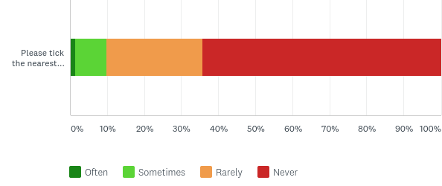
ROADS, VERGES & BYWAYS
50% feel negatively about the condition of roads, verges and byways
3%
26%
20%
38%
12%
Although 68% feel positive about footpaths & rights of way
63% use the footpath through churchyard sometimes or often
2%
14%
54%
21%
10%
26%
37%
23%
14%
Bar chart Q1d: Answered: 155 Skipped: 3 | Q1m: Answered 154 Skipped 4 | Q2c: Answered 155 Skipped 3

Slide 2
OTHER: aspects of village life
Crime rate
34%
47%
16%
7%
Dog Fouling
6%
23%
38%
26%
7%
Litter
7%
43%
29%
18%
3%
Mobile library
7%
24%
65%
1%
3%
Post Office
14%
40%
36%
6%
3%
Airfield use by Military
29%
47%
21%
3%
1%
Airfield use eg: Gliding club
21%
50%
25%
2%
1%
Village community
44%
36%
12%
7%
1%
Village hall events classes & groups
41%
38%
28%
1%
Q1 e: Answered 153 | f: Answered 155 | g: Answered 154 | h: Answered 152 | k: Answered 151 | s: Answered 156 | t, u, v: Answered 157

Slide 3
OTHER: use of amenities
Mobile Library
3%
14%
78%
6%
Post Office
18%
31%
19%
32%
Rec: Fitness equipment
12%
25%
61%
2%
Rec: playing field
8%
29%
33%
30%
Events in village hall
36%
33%
22%
9%
Classes in village hall
8%
10%
20%
61%
Groups in village hall
25%
12%
19%
44%
Q2 d: answered 155 | e, f: answered 153 | g: answered 152 | h: answered 154 | I, j: answered 153

Slide 4
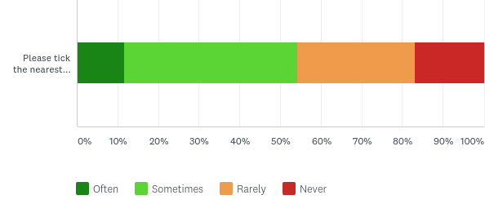
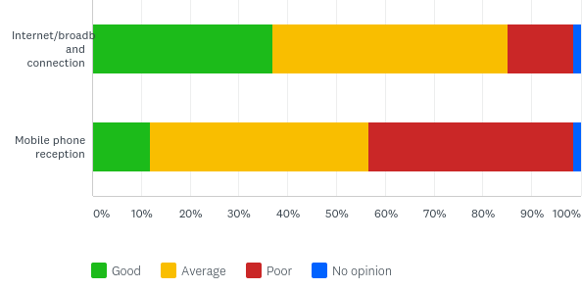
OTHER: use of amenities
Over half respondents use the village shop in Steeple Ashton sometimes or more often
12%
43%
29%
17%
Reasonable levels of internet/broadband connection
But mobile phone reception remains broadly poor
37%
48%
13%
1%
12%
45%
42%
1%
Q3: Answered 155 skipped 3 | Q28 a: Answered 149 skipped 9 | b: Answered 152 skipped 6

Slide 5
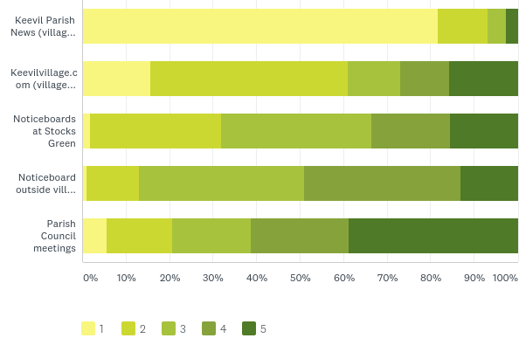
OTHER: Sources of information
Parish News is the most important source of information about what’s happening in Keevil, followed by the village website
Keevil Parish News average rank 4.7
82%
11%
4%
3%
KeevilVillage.com average rank 3.4
16%
45%
12%
11%
16%
Stocks Green noticeboards average rank 2.8
2%
30%
34%
18%
16%
Village Hall noticeboard average rank 2.5
1%
12%
38%
36%
13%
Parish Council meetings average rank 2.2
6%
15%
18%
23%
39%
Rank order
Q29: Answered 151 skipped 7

Slide 6


158 surveys completed
0-5 yrs
You are:
You’ve lived in Keevil for…
Female
Male
>20 yrs
6-10 yrs
11-20 yrs
Age in life…
1%
2%
2%
6%
13%
22%
34%
15%
4%
Career status
1%
1%
5%
20%
8%
11%
10%
6%
4%
60%
Rich vein of free text responses across whole survey: 974 comments totalling over 20,000 words
Charts - Q19: Answered: 146 Skipped: 12 | Q20: Answered: 134 Skipped: 24 | Q21 Answered 142 Skipped 16 | Q22 Answered 143 Skipped 15

Slide 7
Children…
4 children
1 child at a pre-school
3 children
9 children at Keevil School
2 children
11 children at Secondary School
No children
6% of households
that responded have
children under 12
Of those that responded,
12 households have children at Primary or Secondary School
Q33: Answered 90 Skipped 68 | Q34: Answered 63 Skipped 95

