Slide 1
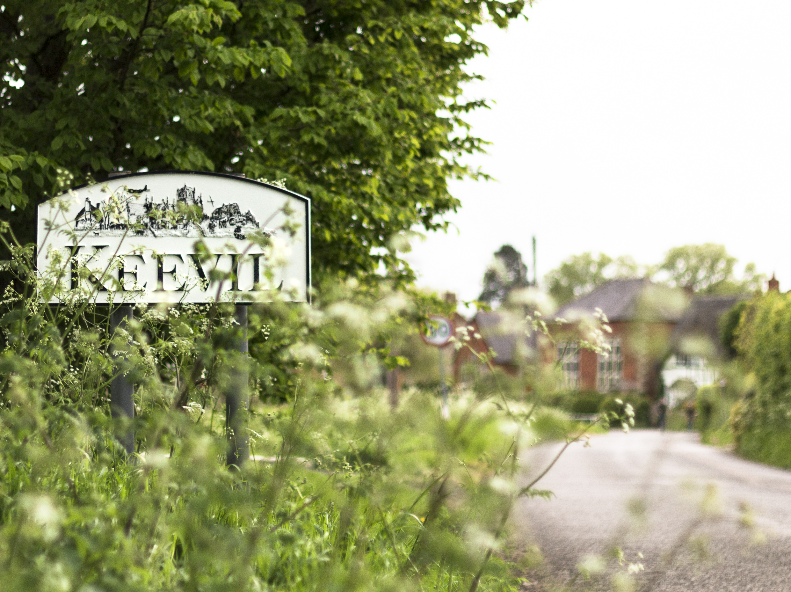
Preliminary Feedback
Village Survey 2019
13th May 2019

Slide 2


158 surveys completed
0-5 yrs
You are:
You’ve lived in Keevil for…
Female
Male
>20 yrs
6-10 yrs
11-20 yrs
Age in life…
1%
2%
2%
6%
13%
22%
34%
15%
4%
Career status
1%
1%
5%
20%
8%
11%
10%
6%
4%
60%
Rich vein of free text responses across whole survey: 974 comments totalling over 20,000 words

Slide 3

Freetext commments

Slide 4
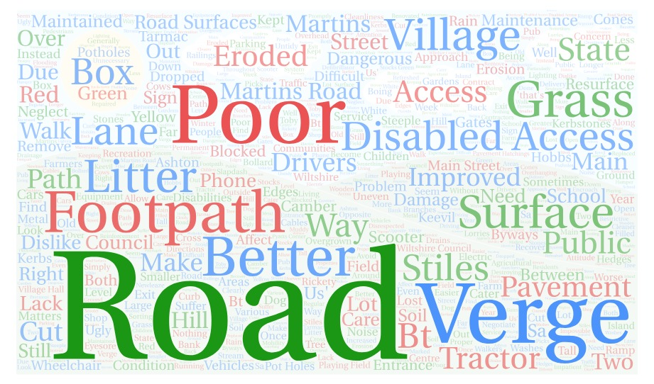

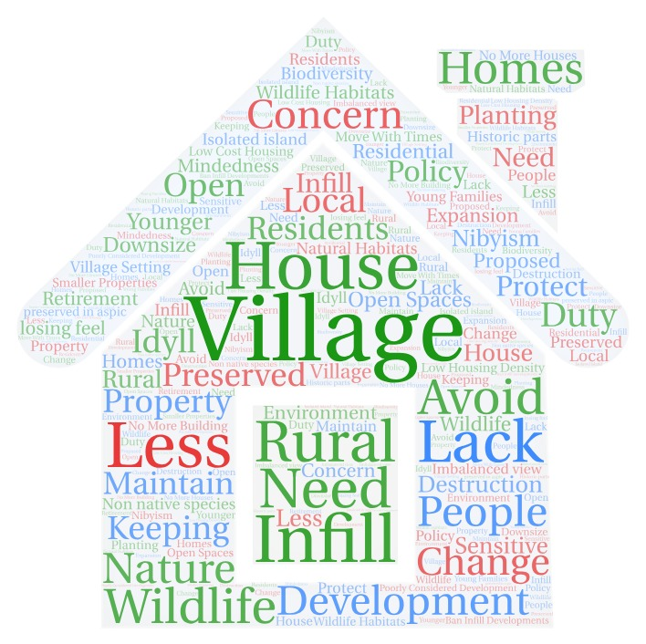
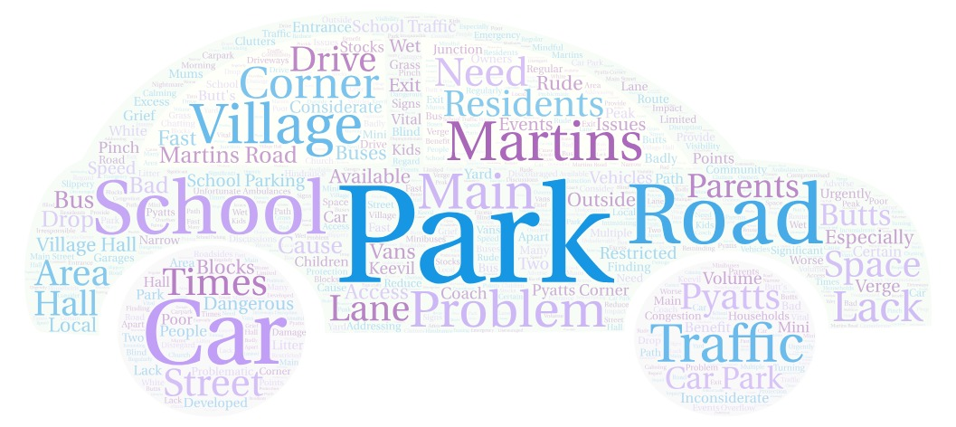
THE KEY THEMES
Parking
Roads
Verges
Byways
Transport
Bus
Housing
Development
Traffic speed/volume

Slide 5

PARKING
“car parking needs urgently addressing Martins Road Pyatts Corner”
“Parking near village hall problematic, and cars park badly at entrance to Martins Road causing restricted visibility when attempting to exit onto Main Street.”
56% of respondents feel negatively about the availability of parking
5%
14%
26%
39%
17%
“On-street parking problem Martins Road”
“school poor parking”
5%
14%
26%
39%
17%

Slide 6
TRAFFIC SPEED/VOLUME
“Main Street relatively dangerous for pedestrians due to increase in traffic, esp farm vehicles, & lack of pavements”
“Baldham residents regularly affected by crashes, lorries, speeding traffic preventing safe exit. Keevil seems not concerned about issue at edge of parish - helpful if worked with Seend, which IS concerned”
45% of respondents feel negative about SPEED, and 30% negative about VOLUME of traffic in the village*
2%
19%
34%
31%
14%
4%
21%
45%
19%
11%
“Increasing traffic passing through village at rush hour.”
“Speed of traffic: school parents”

Slide 7

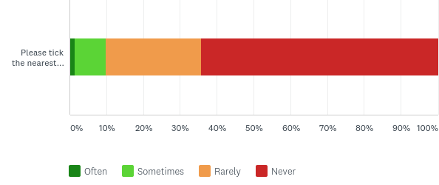
TRANSPORT/BUS
Currently affecting around a third of respondents, an improvement in the bus service would impact positively on these and probably many other residents
“More frequent bus service”
“Set up Community Bus Steeple Ashton, Great Hinton & Bulkington”
“Following Seend’s lead, a Community Bus shared with other local villages.”
Almost one third of respondents feel negative about the availability of the bus service
4%
17%
50%
23%
7%
And more than a third do use the bus at least occasionally, including for leisure…
2%
11%
25%
62%
9%
26%
64%
1%
“fear of being unable to drive, in view of poor public transport.”

Slide 8
ROADS/VERGES/BYWAYS
“Better maintenance of Main Street road surfaces, reinforcement of stream bank Longleaze Farm -Towmead Lane”
“road surfaces improvement, better tree maintenance”
50% feel negatively about the condition of roads, verges and byways
3%
26%
20%
38%
12%
“Proper accessible footpath between Steeple Ashton & Keevil, so children could walk to school and villagers could walk to shop & pub, even when muddy or when cows are out.”

Slide 9
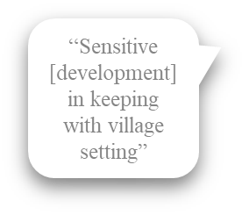
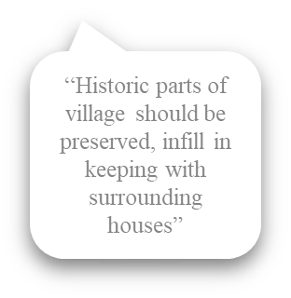
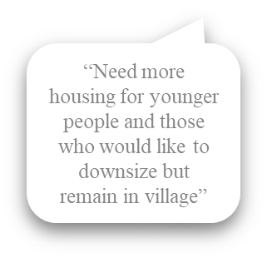
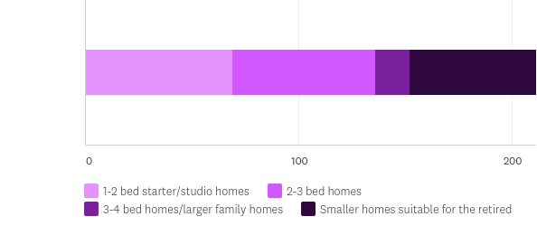
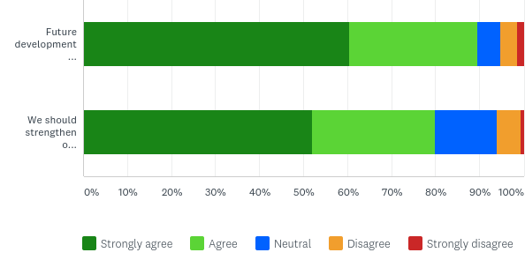
HOUSING/DEVELOPMENT
Respondents recognise the need for smaller and more affordable homes in Keevil
59%
57%
14%
50%
17%
25
59%
90% of respondents believe any future development should be in keeping with the existing landscape and character setting…
… and 80% of respondents agree we should strengthen our existing protection for the conservation of our landscape
61%
29%
5%
4%
52%
28%
14%
5%
1%
1%

Slide 10
ACTION AND NEXT STEPS
Actions:
Traffic plan/school traffic
Termly meeting with the school
Footpaths
Liaising with Seend PC
Next steps:
Monday July 1st after the Parish Council Meeting:
Feedback, Q & A and working groups structure
Access a PDF of the full data: https://keevilvillage.com/parish-council/future-of-keevil-survey/

