Slide 1

Traffic: PARKING
56% of respondents feel negatively about the availability of PARKING in the village
5%
14%
26%
39%
17%
Comments clearly highlighted issues Martins Road/Pyatts Corner & at the School (although feelings towards school broadly positive )
23%
33%
32%
10%
3%
Q1j: Answered: 155 Skipped: 3 | Q1p: Answered: 155 Skipped: 3

Slide 2
Traffic: SPEED & VOLUME
45% of respondents feel negative about the SPEED of traffic in the village
2%
19%
34%
31%
14%
30% of respondents feel negative about the VOLUME of traffic in the village
4%
21%
45%
19%
11%
Q1q: Answered: 156 Skipped: 2 | Q1r: Answered: 156 Skipped: 2

Slide 3

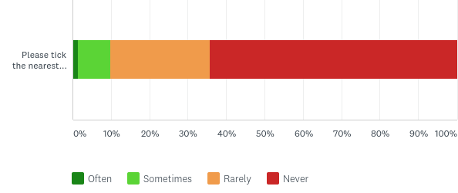
BUS SERVICES
Almost one third of respondents feel negative about the availability of the bus service
4%
17%
50%
23%
7%
More than a third do use the bus at least occasionally…
2%
Use of bus in Keevil
11%
25%
62%
Use of bus for leisure or recreation
9%
26%
64%
1%
Bar Chart Q1b: Answered: 153 Skipped: 5 | Q2a: Answered: 150 Skipped: 8 | Q12: Answered: 151 Skipped: 7

Slide 4
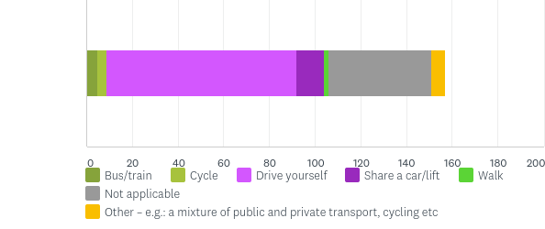
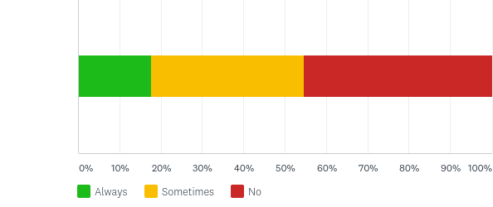
TRANSPORT
Two thirds respondents feel positive that we have good access to nearby towns, major routes and cities
Proximity to other towns
21%
49%
28%
2%
Access to major routes & cities
16%
52%
25%
7%
Most people drive when they go to work outside the parish
55% of those working/studying do so at home at least sometimes
4%
3%
1%
4%
62%
9%
34%
18%
37%
45%
Q1a & Q1l Answered: 153 Skipped: 5 | Q11 Answered 143 Skipped 24 | Q23 Answered 108 Skipped 50

Slide 5
ROADS, VERGES & BYWAYS
50% feel negatively about the condition of roads, verges and byways
3%
26%
20%
38%
12%
Although 68% feel positive about footpaths & rights of way
63% use the footpath through churchyard sometimes or often
2%
14%
54%
21%
10%
26%
37%
23%
14%
Bar chart Q1d: Answered: 155 Skipped: 3 | Q1m: Answered 154 Skipped 4 | Q2c: Answered 155 Skipped 3

Slide 6
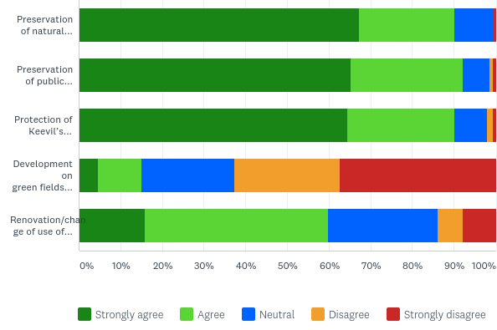
Housing & Dev: ENVIRONMENT
Vast majority want to protect landscape & conservation area, and disagree with development on fields/farmland
1%
Preservation of local habitats & local wildlife
67%
23%
9%
1%
1%
Preservation of public footpaths & rights of way
65%
27%
7%
1%
Protection of Keevil's conservation areas & historic buildings
1%
64%
26%
8%
Development on green fields or farmland
10%
22%
25%
37%
5%
Renovation/change of use of existing buildings to create new homes or workspaces
16%
44%
26%
6%
8%
Q15a: Answered 153 Skipped 5 | Q15b: Answered 153 Skipped 5 | Q15c: Answered 152 Skipped 6 | Q15d: Answered 153 Skipped 5 | Q15e: Answered 152 Skipped 6

Slide 7
Housing & Dev: ENVIRONMENT
> 80% respondents are strongly positive about the local rural environment and wildlife
1%
Natural habitats & local wildlife
23%
61%
12%
3%
Rural environment & open spaces
31%
52%
16%
2%
67% are positive about the playing field & equipment
Two thirds positive about church & churchyard, using it and the footpath at least sometimes
1%
Church/yard
11%
17%
50%
28%
23%
41%
26%
Footpath
14%
3%
26%
37%
23%
Q1i: Answered 155 skipped 3 | Q1o: Answered 154 skipped 4 | Q1n: Answered 155 skipped 3 | Q1c: Answered 155 skipped 3 | Q2b and c: Answered 155 skipped 3

Slide 8
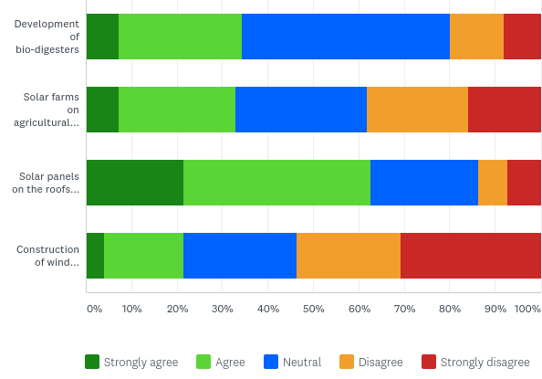
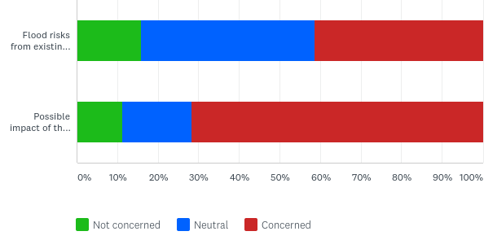
Housing & Dev: ENVIRONMENT
Respondents broadly support renewable energy but > 50% disagree with wind farms
Some concerns at flood risk but far more concern if airfield use were to change
7%
7%
4%
16%
11%
22%
18%
27%
26%
17%
25%
43%
29%
41%
46%
23%
72%
22%
24%
41%
12%
7%
31%
16%
8%
7%
Bio-digesters
Solar farms on farmland
Solar panels on non-dom
Wind turbines
Flood risks from waterways & ditches
Possibility of airfield being put to other use
Q16a: Answered 151 Skipped 7 | Q16b Answered 152 Skipped 6 | Q16c: Answered 153 Skipped 5 | Q16d Answered 153 Skipped 5 | Q14a&b Answered 152 Skipped 6

Slide 9
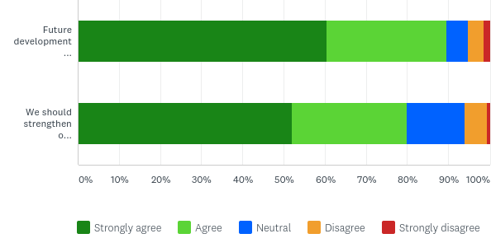
Housing & Dev: ENVIRONMENT
90% of respondents feel any future development should be in keeping with existing landscape & character setting…
61%
29%
5%
4%
1%
… and 80% agree we should strengthen our existing protection for the conservation of our landscape
52%
28%
14%
5%
1%
Q17a: Answered: 152 Skipped: 6 | Q17b: Answered: 150 Skipped: 8

Slide 10
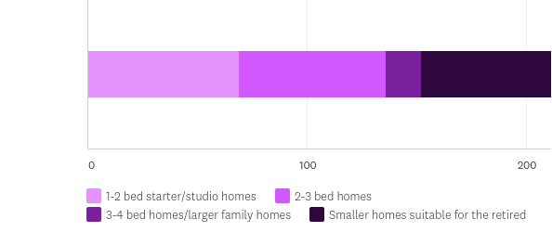
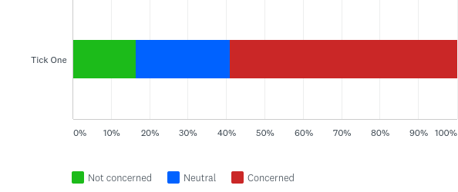
HOUSING & DEVELOPMENT
Currently Keevil is classed as a small village within Wiltshire Council Core Policy which currently allows infill only (one to two homes) in our village.
Although respondents recognise the need for smaller and more affordable homes
59%
57%
14%
50%
59% of respondents would be concerned if Core Policy changed to allow more homes/small developments…
17%
25%
59%
Q9: Answered: 117 Skipped: 41 | Q8: Answered: 151 Skipped: 7

Slide 11
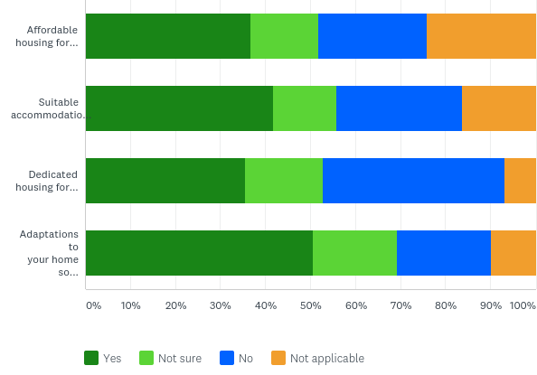
HOUSING & DEVELOPMENT
Existing housing in Keevil (respondents)
Respondents recognise need for change to existing homes if they/their families are to stay in village
Affordable housing for younger people
37%
15%
24%
24%
Suitable accommodation to be able to downsize
42%
14%
28%
16%
Dedicated housing for elderly residents
36%
17%
40%
7%
Adaptations to your home so you can carry on living there
51%
19%
21%
10%
Q35: Answered 98 skipped 60 | Q36: Answered 99 skipped 59 | Q38: Answered: 97 skipped 61

Slide 12
OTHER: aspects of village life
Crime rate
34%
47%
16%
7%
Dog Fouling
6%
23%
38%
26%
7%
Litter
7%
43%
29%
18%
3%
Mobile library
7%
24%
65%
1%
3%
Post Office
14%
40%
36%
6%
3%
Airfield use by Military
29%
47%
21%
3%
1%
Airfield use eg: Gliding club
21%
50%
25%
2%
1%
Village community
44%
36%
12%
7%
1%
Village hall events classes & groups
41%
38%
28%
1%
Q1 e: Answered 153 | f: Answered 155 | g: Answered 154 | h: Answered 152 | k: Answered 151 | s: Answered 156 | t, u, v: Answered 157

Slide 13
OTHER: use of amenities
Mobile Library
3%
14%
78%
6%
Post Office
18%
31%
19%
32%
Rec: Fitness equipment
12%
25%
61%
2%
Rec: playing field
8%
29%
33%
30%
Events in village hall
36%
33%
22%
9%
Classes in village hall
8%
10%
20%
61%
Groups in village hall
25%
12%
19%
44%
Q2 d: answered 155 | e, f: answered 153 | g: answered 152 | h: answered 154 | I, j: answered 153

Slide 14
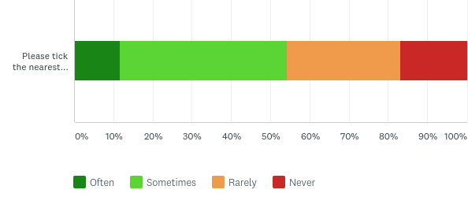
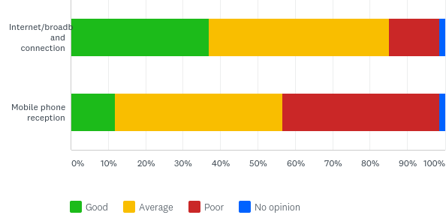
OTHER: use of amenities
Over half respondents use the village shop in Steeple Ashton sometimes or more often
12%
43%
29%
17%
Reasonable levels of internet/broadband connection
But mobile phone reception remains broadly poor
37%
48%
13%
1%
12%
45%
42%
1%
Q3: Answered 155 skipped 3 | Q28 a: Answered 149 skipped 9 | b: Answered 152 skipped 6

Slide 15
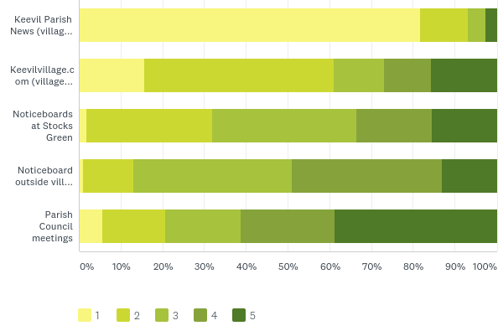
OTHER: Sources of information
Parish News is the most important source of information about what’s happening in Keevil, followed by the village website
Keevil Parish News average rank 4.7
82%
11%
4%
3%
KeevilVillage.com average rank 3.4
16%
45%
12%
11%
16%
Stocks Green noticeboards average rank 2.8
2%
30%
34%
18%
16%
Village Hall noticeboard average rank 2.5
1%
12%
38%
36%
13%
Parish Council meetings average rank 2.2
6%
15%
18%
23%
39%
Rank order
Q29: Answered 151 skipped 7

Slide 16


158 surveys completed
0-5 yrs
You are:
You’ve lived in Keevil for…
Female
Male
>20 yrs
6-10 yrs
11-20 yrs
Age in life…
1%
2%
2%
6%
13%
22%
34%
15%
4%
Career status
1%
1%
5%
20%
8%
11%
10%
6%
4%
60%
Rich vein of free text responses across whole survey: 974 comments totalling over 20,000 words
Charts - Q19: Answered: 146 Skipped: 12 | Q20: Answered: 134 Skipped: 24 | Q21 Answered 142 Skipped 16 | Q22 Answered 143 Skipped 15

Slide 17
Children…
4 children
1 child at a pre-school
3 children
9 children at Keevil School
2 children
11 children at Secondary School
No children
6% of households
that responded have
children under 12
Of those that responded,
12 households have children at Primary or Secondary School
Q33: Answered 90 Skipped 68 | Q34: Answered 63 Skipped 95

